Slide 1



BDP
CREDIT CARD FRAUD DETECTION:
Using PySpark
BHAVIKMANWANI (202318009
MANTHAN SOLANKI (202318012)
ANMOLPOONIA (202318009)

Slide 2

PROBLEM DESCRIPTION:
In the realm of financial transactions, credit card fraud poses a significant challenge for both consumers and financial institutions. The rapid growth of digital transactions has made it easier for fraudsters to exploit vulnerabilities in payment systems. To combat this issue, advanced techniques such as machine learning can be employed to detect fraudulent activities in real-time.
The objective of this project is to develop a credit card fraud detection system using PySpark, a powerful tool for big data processing and machine learning in the Python ecosystem. The dataset consists of a large number of credit card transactions, each characterized by various features such as transaction amount, merchant category, time of transaction, etc. The challenge lies in identifying patterns and anomalies that indicate potential fraudulent behavior.

Slide 3





METHODOLOGY:
01
02
03
04
Data Collection
Data Preprocessing
EDA
Feature Engineering
05
06
Model Building
Model Evaluation

Slide 4





TOOLS & TECH USED:
DATABRICKS
PYSPARK

Slide 5
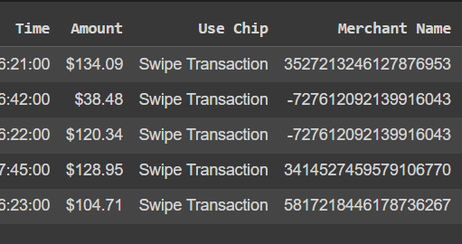
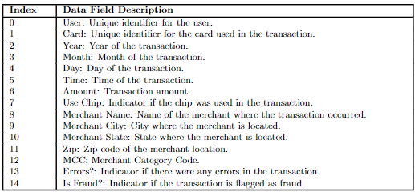
Dataset Source:
https://www.kaggle.com/datasets/ealtman2019/credit-card-transactions?select=credit_card_transactions-ibm_v2.csv
Dataset Description: Size- 2.35 GB

Slide 6
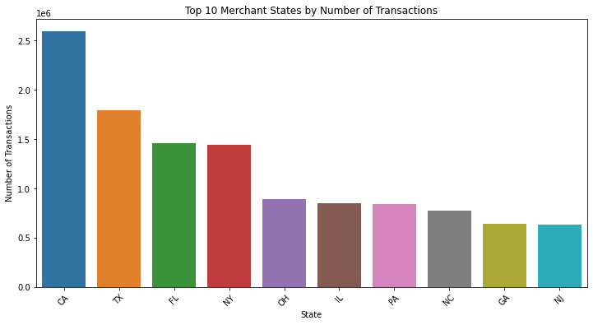
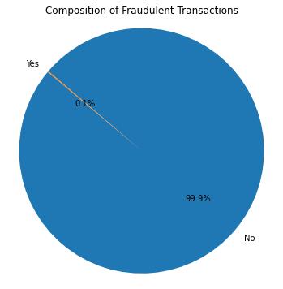
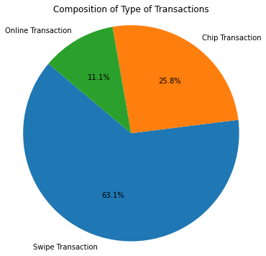
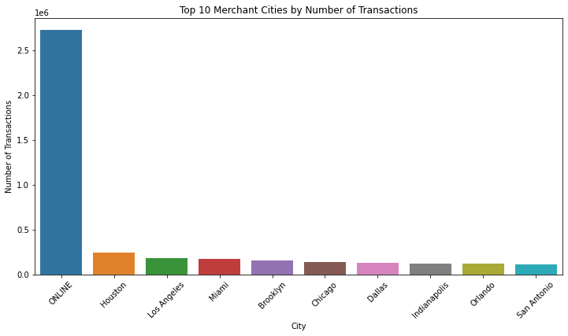
EXPLORATORY DATA ANALYSIS:
Bar Chart showing comparison of States by volume of Transactions
Pie Char Showing percentage of fraud transactions
0.1%
CALIFORNIA LEADING IN TERMS OF VOLUME
OF TRANSACTION IS BEING DETECTED AS FRAUDELENT
63.1%
pie chart showing comparison of types of transactions
Bar Chart showing comparison of cities
OF TRANSACTION IS BEING IDENTIFIED AS SWIPE BASED TRANSACTIONS
MAJORITY FRAUD TRANSACTION DETECTED ON ONLINE MODE RATHER THAN MERCHANT LEVEL

Slide 7
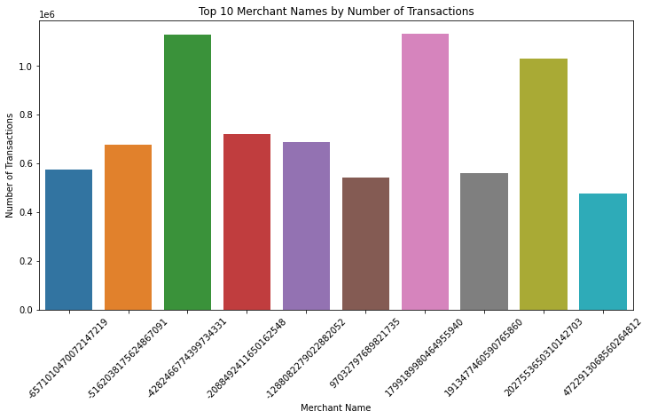
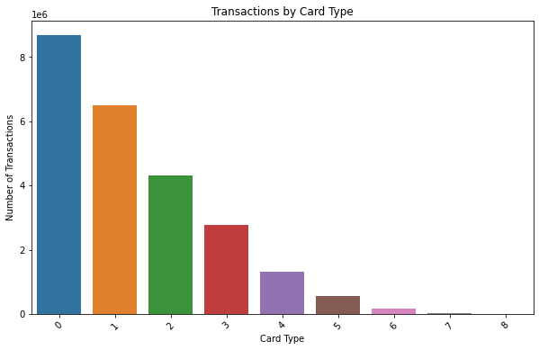
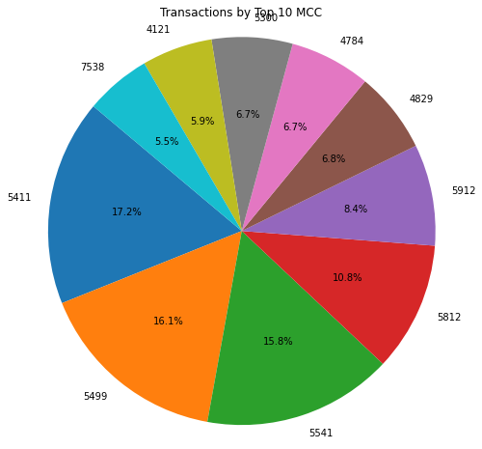


BAR CHAR SHOWING COMPARISON OF MERCHANTS
BAR CHART SHOWING COMPARISON OF CARD TYPES
pie chart showing comparison of MCC
WITH MCC 5411 LEADING BY 17.2%

Slide 8




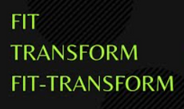
Feature Engineering:
1
2
3
4
5
String Indexing:
One-Hot Encoding:
Vector Assembling:
Pipeline Creation:
Fit-Tranform:
String indexing is used to convert categorical string columns into numerical indices. Three columns are indexed: "Merchant City", "Use Chip", and "MCC".
One-hot encoding is used to convert the indexed categorical columns into one-hot encoded vectors. This transformation prepares the categorical data for machine learning algorithms.
Vector assembly is used to assemble multiple columns, including the one-hot encoded vectors and numerical columns, into a single feature vector column named "features".
A pipeline is created to sequentially apply the transformations, including indexing, one-hot encoding, and vector assembly, to the data.
The pipeline is fitted to the data, determining the transformation parameters (e.g., category-to-index mappings) from the data.

Slide 9

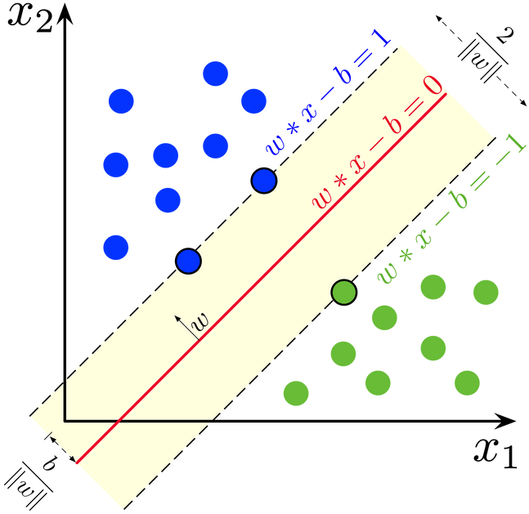
ML MODELS:
Support Vector Classifier:
Logistic Regression:

Slide 10

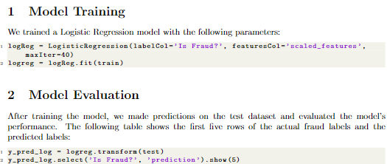
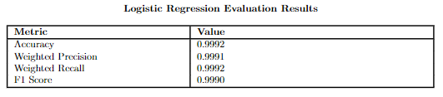
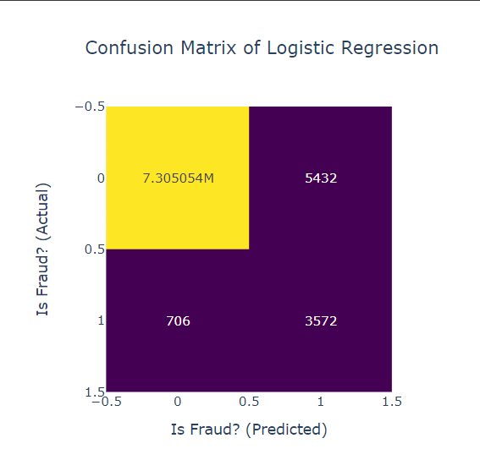
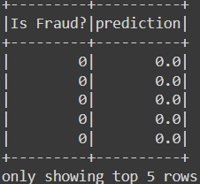
Logistic Regression:

Slide 11
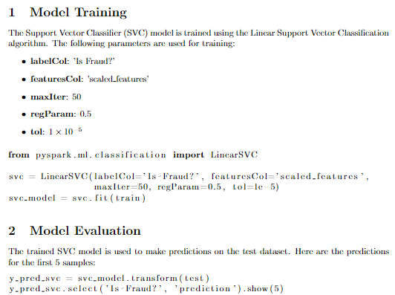
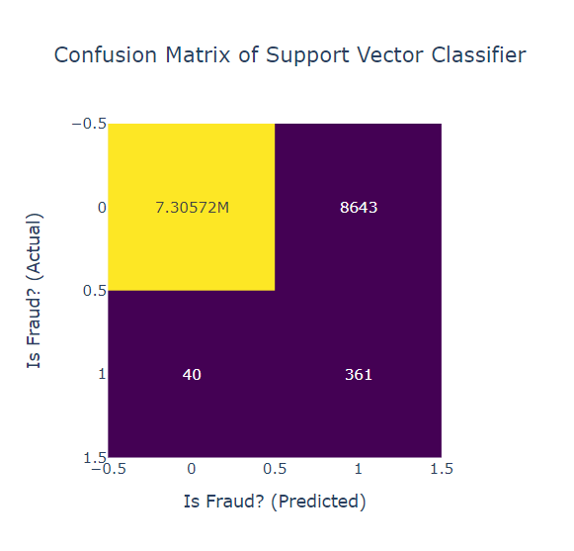
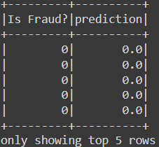
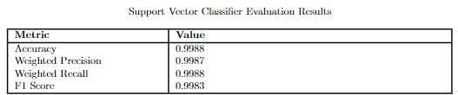

Spport Vector Classifier:

Slide 12
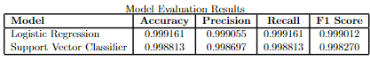
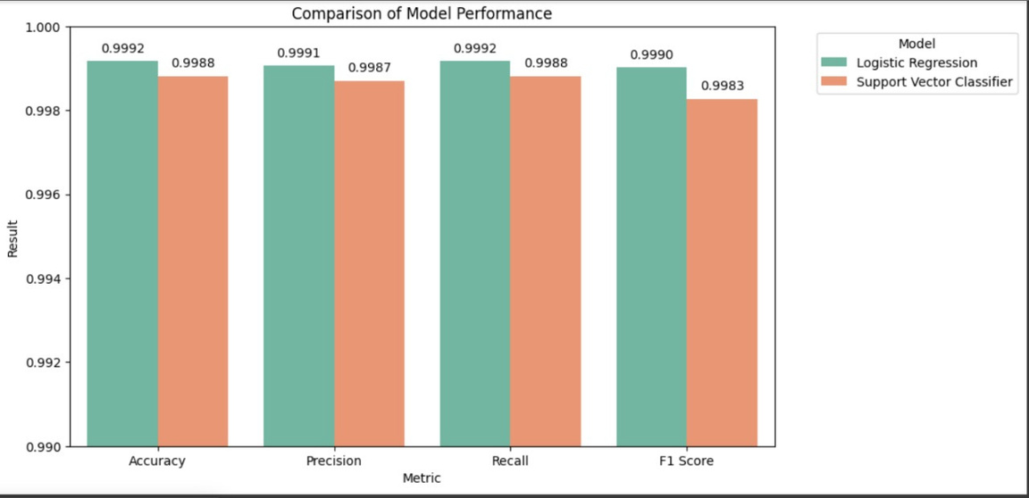
COMPARISON ANALYSIS OF LR AND SVM:
ACCURACY:
LR > SVM
PRECISION:
LR > SVM
RECALL:
LR > SVM
F1 SCORE:
LR > SVM

Slide 13



REFERENCES
• NUTAN BHOGENDRA SHARMA. ”FEATURE TRANSFORMER: VECTORASSEMBLER IN PYSPARK ML FEATURE (PART 3)”. MEDIUM. [ONLINE]. AVAILABLE: HTTPS://MEDIUM.COM/@NUTANBHOGENDRASHARMA/FEATURE-TRANSFORMER-VECTORASSEMBLER-IN-PYSPARK-ML-FEATURE-PART-3-B3C2C3C93EE9#:~:TEXT=VECTORASSEMBLER%20IS%20A%20TRANSFORMER%20THAT,LOGISTIC%20REGRESSION%20AND%20DECISION%20TREES.
• Nutan Bhogendra Sharma. ”Role of StringIndexer and Pipelines in PySpark ML Feature”. Medium. [Online]. Available: https://medium.com/@nutanbhogendrasharma/role-of-stringindexer-and-pip
• Nutan Bhogendra Sharma. ”Role of OneHotEncoder and Pipelines in PySpark ML Feature (Part 2)”. Medium. [Online]. Available: https://medium.com/@nutanbhogendrasharma/role-of-onehotencoder-and-pipelines-in-pyspark-ml-feature-part-2-3275767e74f0.
• Qiang Yan, Yongli Liu, Hao Shen, Zhiwen Yu, Xianhai Yu. ”A new artificial bee colony algorithm for selecting optimal features in machine learning-based software defect prediction”. ScienceDirect. [Online]. Available: https://www.sciencedirect.com/science/article/ pii/S187705092030065X.
• Kaggle. ”Credit Card Transactions”. Kaggle. [Online]. Available: https://www.kaggle.com/datasets/ealtman2019/credit-card-transactions?select=credit_card_transactions-ibm_v2.csv
• Vidyasagar Machupalli. ”Building a Credit Card Fraud Detection Online Training Pipeline with River ML and Apache Flink”. Towards Data Science. [Online]. Available: https://towardsdatascience.com/building-a-credit-card-fraud-detection-online-training-pipeline-with-ri
• Analytics Vidhya. ”Support Vector Machines(SVM) – A Complete Guide For Beginners”. Analytics Vidhya. [Online]. Available: https://www.analyticsvidhya.com/blog/2021/ 10/support-vector-machinessvm-a-complete-guide-for-beginners/.
• Builtin. ”Logistic Regression: Understanding Building Simple Models in Python”. Builtin.
[Online]. Available: https://builtin.com/articles/logistic-classifier.

